Slide 1
Web scraping with Python
workshop, 08.09.2019

Slide 2
Goals
Understand what web scraping is and how it works
Know tools that let you perform web scraping
Be able to perform a simple custom web scraping task
Know different practical ways to extract information from content
Know common problems and limitations

Slide 3
Agenda
30 min Introduction, scraping example
60 min Scrapy I
30 min HTML, CSS, XPath crash course
30 min Lunch break
70 min Scrapy II, parsing other formats, text mining
30 min URL sources (Google Search)
20 min PS, questions

Slide 4
Material
Download the workshop material from
https://tubcloud.tu-berlin.de/s/ggpsR83Q72F5yRb
Note: Some examples contain Google API keys which will be deleted after the workshop

Slide 5
Introduction

Slide 6
Web scraping
Web: World Wide Web: “the system of connected documents on the internet, usually with pictures, video, and sound, that can be searched for information about a particular subject”
Scraping: “to remove an unwanted covering or a top layer from something, especially using a sharp edge or something rough”
Web scraping, web harvesting, or web data extraction is data scraping used for extracting data from websites. (Wikipedia)
https://dictionary.cambridge.org

Slide 7
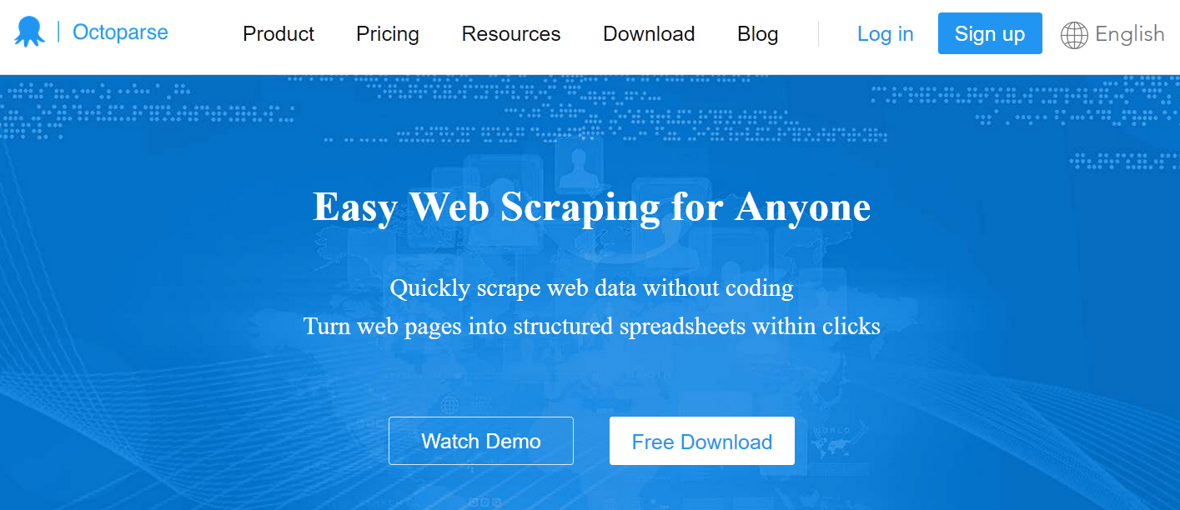
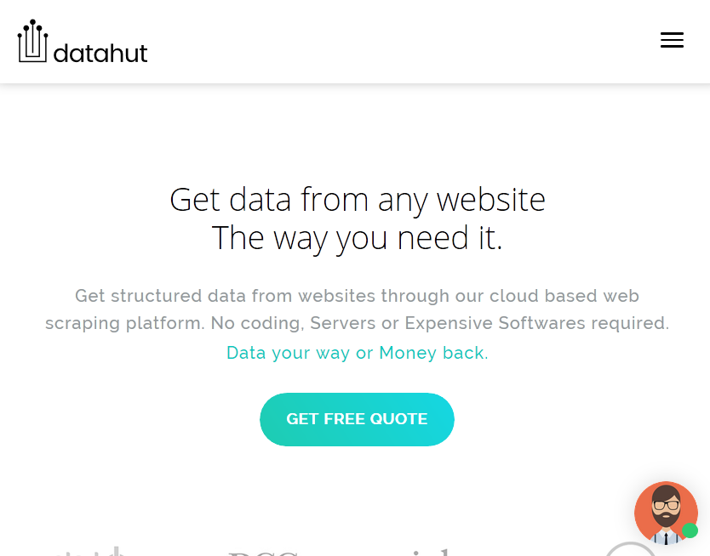
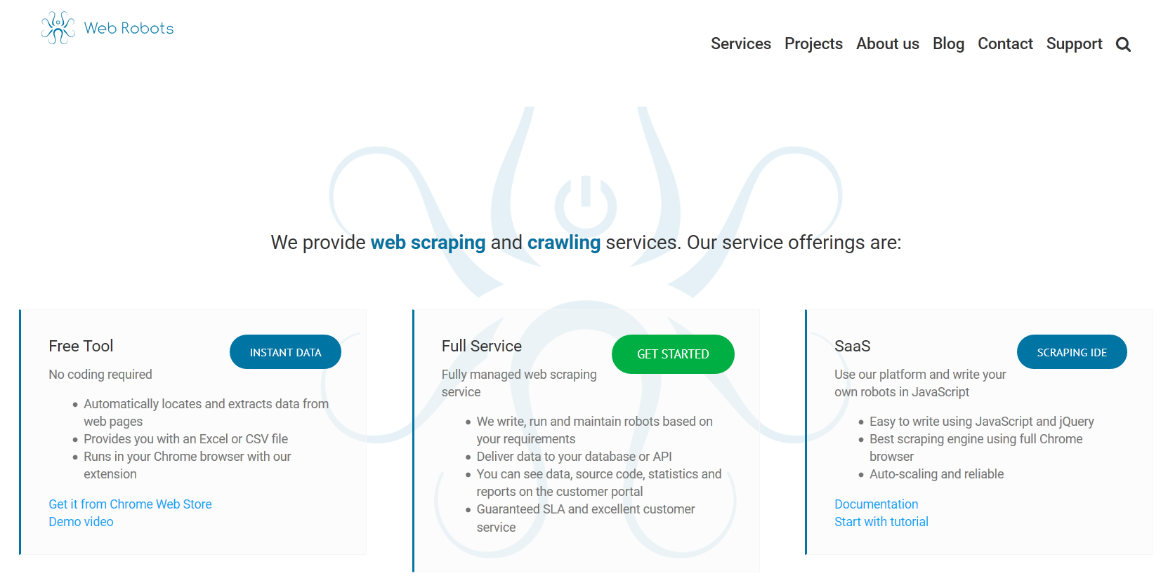
Services & tools

Slide 8

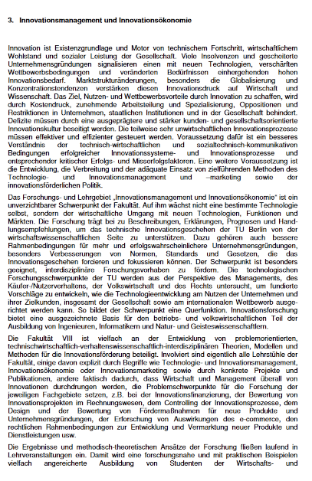
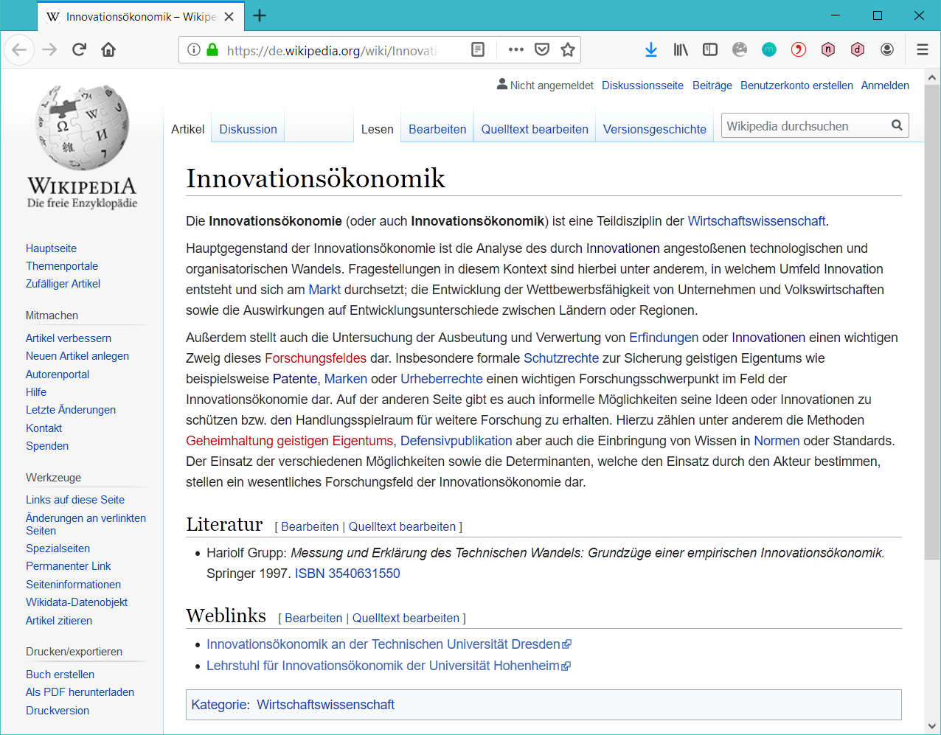




Common process
question / problem
google keyword search
web crawling
identify sources
database
twitter stream
…
URLs
“Web Crawling”
fetch sources
HTTP
API
data
web crawling
…
parse content
HTML
XML
JSON
“Data Harvesting”
Unstructured text
structured data
Excel
CSV
…
“Data Mining”
extract information
heuristic
RE
information
stochastic model
…

Slide 9

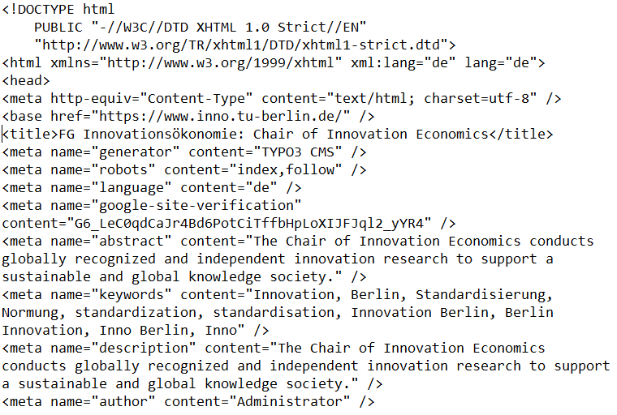
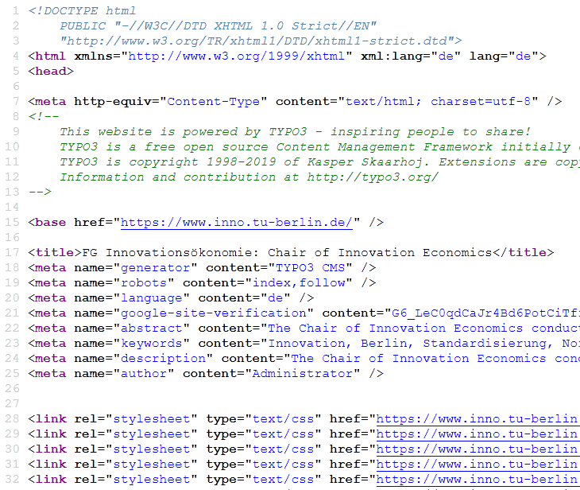
Example
question / problem
Generate a list of e-mail addresses of people that appear when you google “innovation economics”
identify sources
TOP 5 results google search with keyword “innovation economics”
URLs
TOP 5000 ?
fetch sources
download each website by hand using a web browser
data
parse content
parse the HTML content
structured data
extract information
search for ‘@’ symbol or mailto: in links to identify e-mail addressess
person1@tu-berlin.de
Person2<at>tu-berlin.de
…
information

Slide 10
Collecting e-mail addresses
Example:
Collecting all e-mail addresses of people and organizations associated with „innovation economics“ (by Google results).
<Browser>

Slide 11
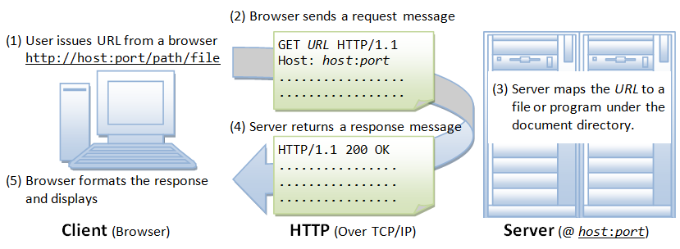
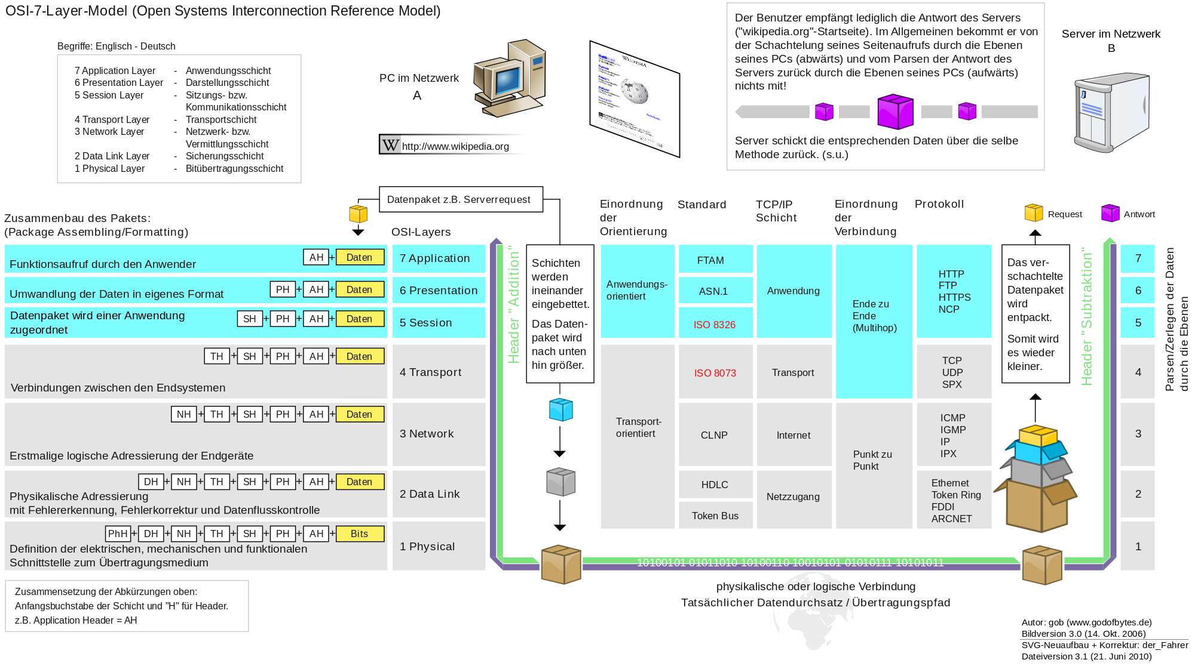


Slide 12
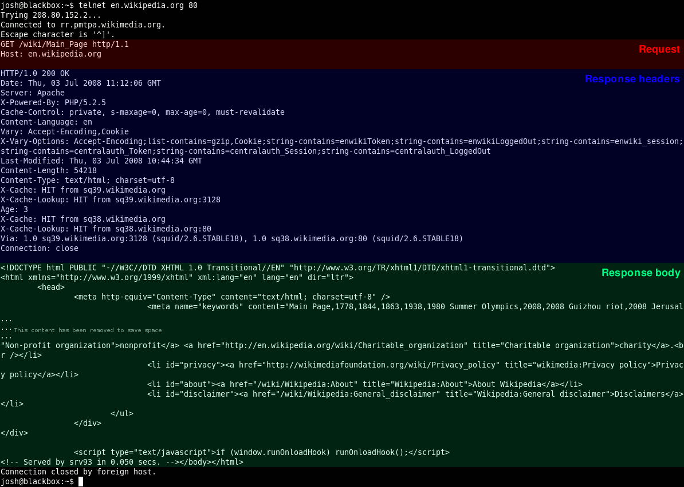

Slide 13




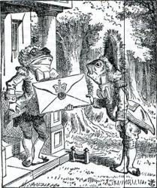


In Python
operationalized problem
db, google, twitter …
identify sources
URLs
fetch sources
data
parse content
structured data
CSS selectors
XPath
Regular Expressions
extract information
Beautiful Soup
NLTK
information

Slide 14
Collecting e-mail addresses
Example:
Collecting all e-mail addresses of people and organizations associated with „innovation economics“ (by Google results).
scrapy crawl google_inno –o emails.csv
scrapy command
spider name
where to save output

Slide 15
Scrapy I

Slide 16
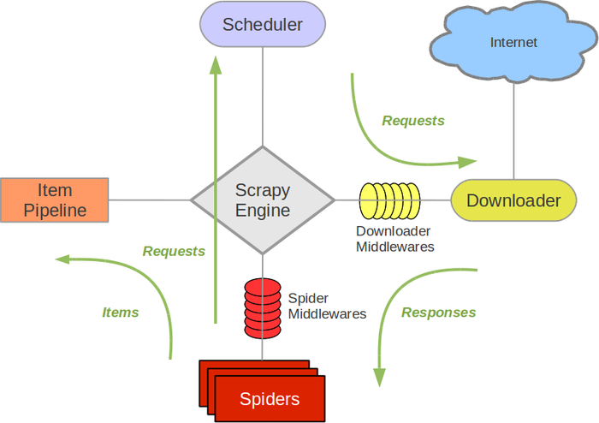
Scrapy Spider
Scrapy is centered around “Spiders” that define which websites to access, how to access them and what to do with the content
A Spider is a pre-defined Scrapy object that you can customize to fit your needs
https://docs.scrapy.org/en/latest/topics/spiders.html https://docs.scrapy.org/en/latest/topics/architecture.html

Slide 17
Scrapy Spider
operationalized problem
identify sources
import scrapy
class MySpider(scrapy.Spider):
name = “myspider”
def start_requests(self):
# generate initial urls yield scrapy.Request(url=url,
callback=self.parse)
def parse(self, response):
# identify next sources
response.follow(url=new_url, self.parse)
# parse / extract info from response
yield some_result
URLs
fetch sources
data
parse content
structured data
extract information
information
https://docs.scrapy.org/en/latest/topics/spiders.html

Slide 18
Scrapy
pip install scrapy
scrapy startproject workshop
workshop
scrapy.cfg
workshop
__init__.py
items.py
middlewares.py
pipelines.py
settings.py
spiders
__init__.py
Exercise (5 mins):
Install scrapy and create a new scrapy project
https://docs.scrapy.org/en/latest/intro/tutorial.html

Slide 19
Crawling
Example:
Collect all titles of websites that are linked on FG Inno‘s website (plus one level of recursion).
scrapy crawl inno –o links.csv
file: /intro/intro/spiders/inno_spider.py

Slide 20
Exercise
Exercise (15 mins):
Collect all (recent) blog posts’ titles from www.innovation-economics.de
Hint: use
response.css('h2.entry-title a::text').extract()
to get a list of all post titles

Slide 21
Solution
import scrapy
class InnoSpider(scrapy.Spider):
name = "innovation-economics"
def start_requests(self):
url = 'http://innovation-economics.de/'
yield scrapy.Request(url=url, callback=self.parse)
def parse(self, response):
post_titles = response.css('h2.entry-title a::text').extract()
for title in zippost_titles:
yield {'title': title}

Slide 22
HTML, CSS, XPath crash course

Slide 23
HTML, CSS, XPath crash course
Extracting information from the web:
Accessing websites ✔
Parsing the content
“the web” is often structured data, most commonly in HTML format, almost always enriched with CSS
HTML (+CSS) represents data in a tree-like structure that can be systematically parsed, e.g. using CSS selectors, or XPath

Slide 24
HTML, CSS, XPath crash course
Example:
Source of website https://www.inno.tu-berlin.de/menue/chair_of_innovation_economics/, Firefox webdeveloper tools

Slide 25
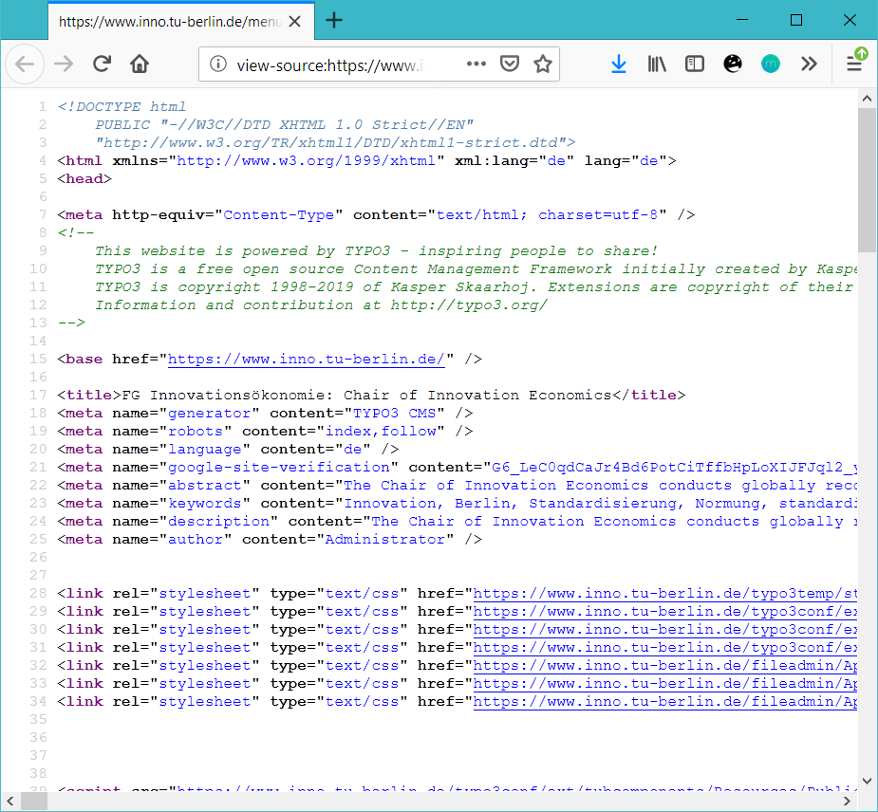

HTML
Hypertext Markup Language
Language to define the structure of a website → structured data!
Rendered by web browser to display website
Info for standardization-nerds:
First developed by Tim Berners-Lee (CERN) in 1991
First standardized at IETF as RFCs in 1993
Developed at W3C since 1997
Currently: HTML5

Slide 26
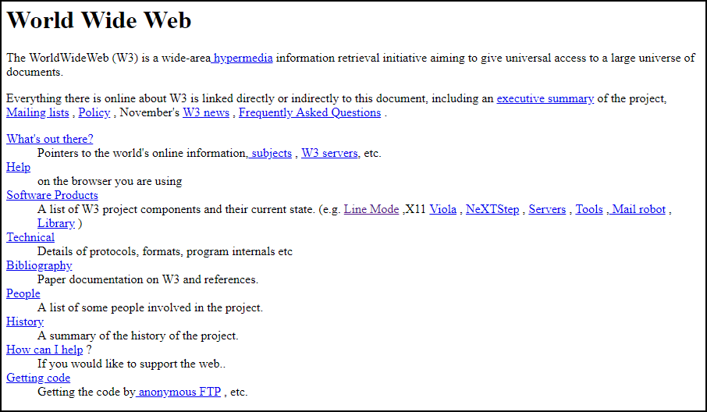
HTML
The world’s first website… http://info.cern.ch/hypertext/WWW/TheProject.html

Slide 27
HTML
<!DOCTYPE html>
<html>
<head>
<title>This is a title</title>
</head>
<body>
<p>Hello world!</p>
</body>
</html>
meta information
content
https://developer.mozilla.org/en-US/docs/Learn/HTML/Introduction_to_HTML

Slide 28
HTML
A link to FG inno!
element
attribute
value
value
<a href="https://www.inno.tu-berlin.de/">
A link to FG inno!
</a>
https://developer.mozilla.org/en-US/docs/Web/HTML/Element/a

Slide 29
HTML: most common elements
<h1>, <h2>, <h3>, <h4>, <h5>, <h6> | The HTML <h1>–<h6> elements represent six levels of section headings. <h1> is the highest section level and <h6> is the lowest.
<div> | The HTML Content Division element (<div>) is the generic container for flow content. It has no effect on the content or layout until styled using CSS.
<p> | The HTML <p> element represents a paragraph.
<ul> | The HTML <ul> element represents an unordered list of items, typically rendered as a bulleted list.
<a> | The HTML <a> element (or anchor element), along with its href attribute, creates a hyperlink to other web pages, files, locations within the same page, email addresses, or any other URL.
<b> | The HTML Bring Attention To element (<b>) is used to draw the reader's attention to the element's contents, which are not otherwise granted special importance.
<br> | The HTML <br> element produces a line break in text (carriage-return). It is useful for writing a poem or an address, where the division of lines is significant.
<img> | The HTML <img> element embeds an image into the document.
<table> | The HTML <table> element represents tabular data — that is, information presented in a two-dimensional table comprised of rows and columns of cells containing data.
https://developer.mozilla.org/en-US/docs/Web/HTML/Element

Slide 30
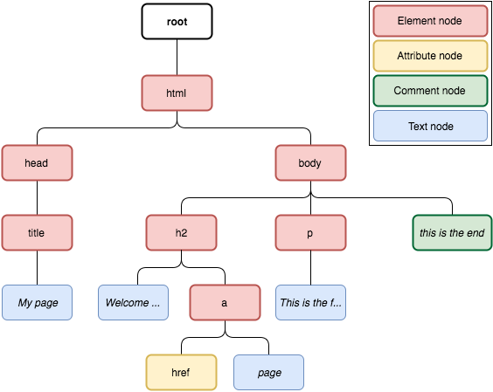
HTML tree
<html>
<head>
<title>My page</title>
</head>
<body>
<h2>Welcome to my <a href="#">page</a>
</h2>
<p>This is the first paragraph.</p>
<!-- this is the end -->
</body>
</html>

Slide 31
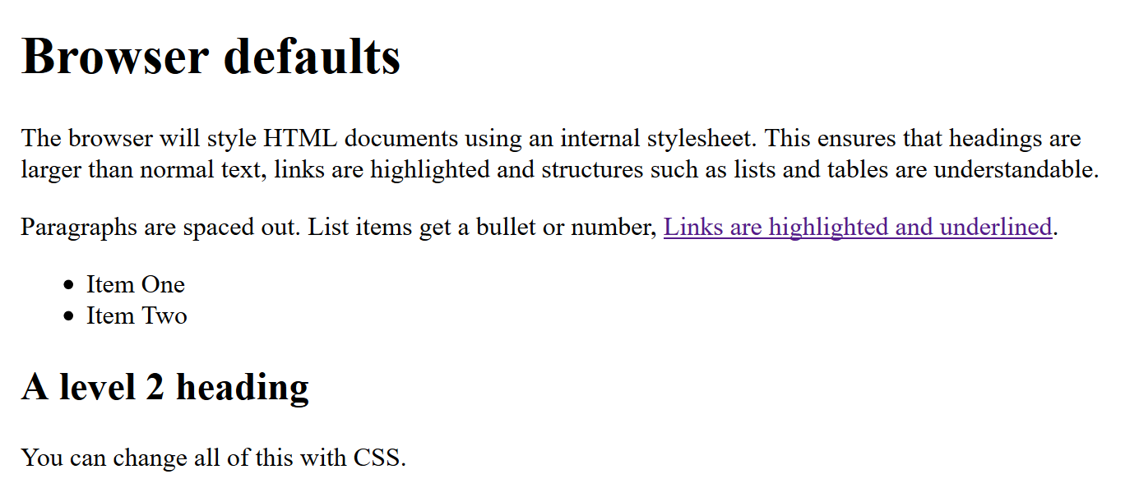
CSS
Mozilla: „CSS (Cascading Style Sheets) is used to style and lay out web pages — for example, to alter the font, color, size, and spacing of your content, split it into multiple columns, or add animations and other decorative features” → often contains additional structure!
https://developer.mozilla.org/en-US/docs/Learn/CSS/First_steps

Slide 32
CSS
h1 {
color: red;
}
p {
color: black;
}
p.sample {
color: #ab7613;
text-align: center;
}
#footnote {
font-size:small;
color: grey;
}
CSS
HTML
<html> <head>…</head>
<body>
<p>paragraph</p>
<p class=“sample”>
sample para
</p>
<p class=“sample”>
sample para
</p>
<div id=“footnote”>
footnotes
</div>
</body>
</html>
class: defines style of a “type” of element → Can appear multiple times in HTML
id: defines style of a unique special element
→ Appears once in HTML

Slide 33
CSS selectors
Most common:
identifying an element: type (element name), class, id
position in tree: descendant, child
css selector | result
h1 | all elements of type “h1” (heading level 1)
a.important | all anchors (links) with class=“important”
#main | the element with id=“main”
p a | all links that are inside a paragraph
p a.important | all links with class=“important” that are inside a paragraph
#main a.important | all links with class=“important” that are inside element with id=“main”
ul.first > li | All list items that direct children of lists “first” (only first level of list)
https://developer.mozilla.org/en-US/docs/Web/CSS/CSS_Selectors

Slide 34
Exercise
Exercise (10 mins):
Look at the source of https://www.inno.tu-berlin.de/menue/about_us/team/
How would you address
the third table (“Research fellows”)
all of the tables in the middle
using CSS selectors?
Hint: F12 opens developer tools in Firefox

Slide 35
Solution
#c447836 table
#main table

Slide 36
CSS selectors in Scrapy
Use CSS selectors to select elements in Scrapy:
response.css(some css selector).get() # first result
...getall() # list of all results
To address the text inside some element use ::text
response.css(“h2::text”).getall() # all 2nd level caption texts
To address an attribute of some element use ::attr(name)
response.css(“a::attr(href)”).getall() # all link urls
https://docs.scrapy.org/en/latest/topics/selectors.html

Slide 37
XPath
Address elements (like with CSS selectors)
Works with any XML document (does not depend on CSS)
XPath | result
//h1 | all elements of type “h1” (heading level 1)
//a[@class=“important”] | all anchors (links) with class=“important”
//*[@id=“main”] | the element with id=“main”
//p//a | all links that are inside a paragraph
//p//a[@class=“…”] | all links with class=“…” that are inside a paragraph
//*[@id=“main”]//a[@class=“…”] | all links with class=“important” that are inside element with id=“main”
//ul[@class=“first”]/li | All list items that direct children of lists “first” (only first level of list)
https://devhints.io/xpath

Slide 38
XPath
Can do a bit more than css selectors
XPath | result
//a[@id != “important”] | all anchors (links) with class other than “important”
//p[a] | all paragraphs with links in them
//div[contains(@class,”crc-”)] | all divs with a classname that contains “crc-”
//table[count(tr)>1] | all tables that contain more than one row
//a | //span[@class=“link”] | all links and spans with class “link”
…
https://devhints.io/xpath

Slide 39
XPath in Scrapy
Use XPath in Scrapy:
response.xpath(“//p[a]”).get() # first result
...getall() # list of all results
To address the text inside some element use text() or string()
response.css(“//h2//text()”).getall() # all 2nd level caption texts
text() vs string(): string puts together the text of itself plus of all its descendants, text does not
https://docs.scrapy.org/en/latest/topics/selectors.html

Slide 40
Exercise
Exercise (10 mins):
Use XPath to get all the names of FG Inno team members from https://www.inno.tu-berlin.de/menue/about_us/team/.
Hints:
F12 opens developer tools in Firefox
Enter $x(“xpath query”) into the developer tools console to run XPath in Firefox

Slide 41
Solution
//*[@id="main"]//tbody//td[1]//text()

Slide 42
30 min LUNCH BREAK

Slide 43
Scrapy II

Slide 44
Scrapy I recap
Scrapy: Create a spider to
collect resources from the web
Initial sources
Add additional sources while parsing
parse the content to extract information. HTML-websites:
CSS selectors
XPath

Slide 45
Scrapy II
Exercise (20 mins):
Collect all names of people working at the chair of innovation economics. (https://www.inno.tu-berlin.de/menue/about_us/team/)

Slide 46
Scrapy II
Example:
Collect all team member names from https://www.inno.tu-berlin.de/menue/about_us/team/ using Scrapy + XPath.
scrapy crawl innoteam –o team.csv
file: /intro/intro/spiders/innoteam_spider.py

Slide 47

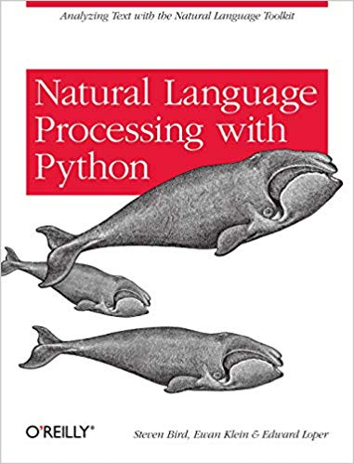
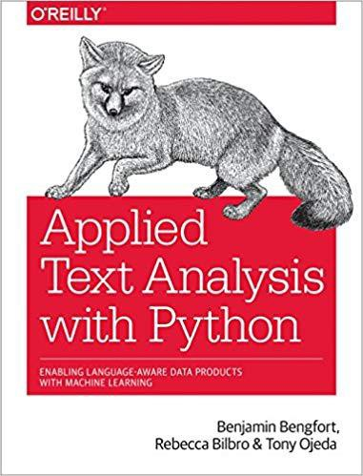
Scrapy II: other formats
(Unstructured) text:
Regular expressions
NLTK (Natural Language Toolkit)
Pyparsing
OpenRefine
scikit-learn
PDF
Word
Excel → Pandas…
…

Slide 48
Scrapy II
Example:
Compare websites using stochastic text models.
Collect website texts with Scrapy: scrapy crawl innoteam –o team.csv file: /intro/intro/spiders/google_inno_text_spider.py
Analyze texts using NLTK and scikit-learn: Jupyter notebook: /intro/inno-text-analysis.ipynb

Slide 49
URL sources

Slide 50
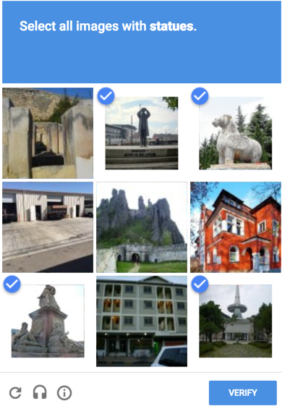
Sources: Google
There is an official Python client that lets you access the Google API (Search and other Google products):
https://github.com/googleapis/google-api-python-client
pip install --upgrade google-api-python-client
A Google API key is required
Limited Access
Simply scraping Google is not that simple:

Slide 51
Sources: Google
Google Search API: http://googleapis.github.io/google-api-python-client/docs/dyn/customsearch_v1.html https://developers.google.com/custom-search/v1/cse/list
getting Google API keys: https://console.cloud.google.com/home/dashboard

Slide 52
Sources: Google
Example:
Collecting all e-mail addresses of people and organizations associated with „innovation economics“ (by Google results).
scrapy crawl google_inno –o emails.csv
file: /intro/intro/spiders/google_inno_spider.py

Slide 53
Sources: Twitter
There are several Python wrappers for access to the Twitter API, e.g.:
https://github.com/bear/python-twitter
pip install python-twitter
Access to Twitter is regulated with API keys, and limited
Twitter does not offer access to historical data – you need to collect over a period of time, or buy data from specialized providers

Slide 54
PS

Slide 55
PS: robot.txt
A webserver usually serves a robot.txt file
It contains information for clients on which rules to follow
Also often contains special rules for web scrapers
You should be polite and obey the rules https://blog.scrapinghub.com/2016/08/25/how-to-crawl-the-web-politely-with-scrapy
Scrapy obeys by default https://docs.scrapy.org/en/latest/topics/settings.html#robotstxt-obey

Slide 56
PS: Scrapy recommended further reading
Login, sessions, forms
Often web sites require input into a form (queries, login, etc.)
Use Scrapy’s FormRequest
Examples: https://doc.scrapy.org/en/latest/topics/request-response.html#request-usage-examples
Item pipelines
https://docs.scrapy.org/en/latest/topics/item-pipeline.html#topics-item-pipeline
Remote control your spiders
https://scrapyd.readthedocs.io/en/stable/

Slide 57
PS: Javascript
Javascript that is included in websites often modifies the DOM and/or dynamically loads content after the website is opened in the web browser
A simple request in Scrapy will produce HTML that is different from that rendered in the browser
Some user interactions can not be easily reproduced without JS
Some websites even specifically use this to hide content against web scrapers

Slide 58
PS: Javascript
Some tools enable automated interaction with web browsers that render JS and even allow “natural” interaction with the website (“clicking buttons” etc.)
Selenium (originally developed for automated web site testing), Selenium-python
+ Firefox / Chrome / PhantomJS (deprecated)
Problem: Rendering JS is slow and should be avoided if possible…

Slide 59
PS: Scaling
Respect server limits (don’t DoS/get IP-banned)
Implement suitable logging and monitoring
Parallelisation
Run parallel HTTP-requests
Parallelize data mining → use processor while waiting for HTTP response (especially for computing-heavy mining tasks)
Fail-safety
Catch timeouts, HTTP errors etc.
Continuously save data (windows updates…)
Content & structure changes…
Remote scraping
https://github.com/scrapy/scrapyd
Don’t block own computer / higher bandwidth
Cronjobs
Closer to scraped servers (scraping Japanese websites?!)

Slide 60
PS: Scaling
Collect 10000 links from Google
Collect 10000 websites
Analyze 10000 websites
serial
Use available features
Collect next n websites
Calculate features for n websites
Collect next n links from Google
parallel
Use available features
Analyze all websites
…

Slide 61
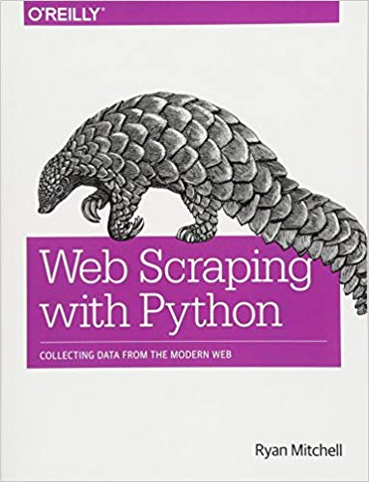
PS: More web scraping
Short: https://doc.scrapy.org/en/latest/intro/overview.html
Long:
Ryan Mitchell: Web scraping with Python (2018)
https://github.com/REMitchell/python-scraping

Slide 62
PS: Even more web scraping
Course on text mining (including web scraping) https://github.com/minhpqn/Text-Mining-Training-Course
NESTA web scraping Jupyter notebook (thanks Miriam)
https://tubcloud.tu-berlin.de/s/8DGtTaj7iwk8Bms

Slide 63
Questions

